Slide 1
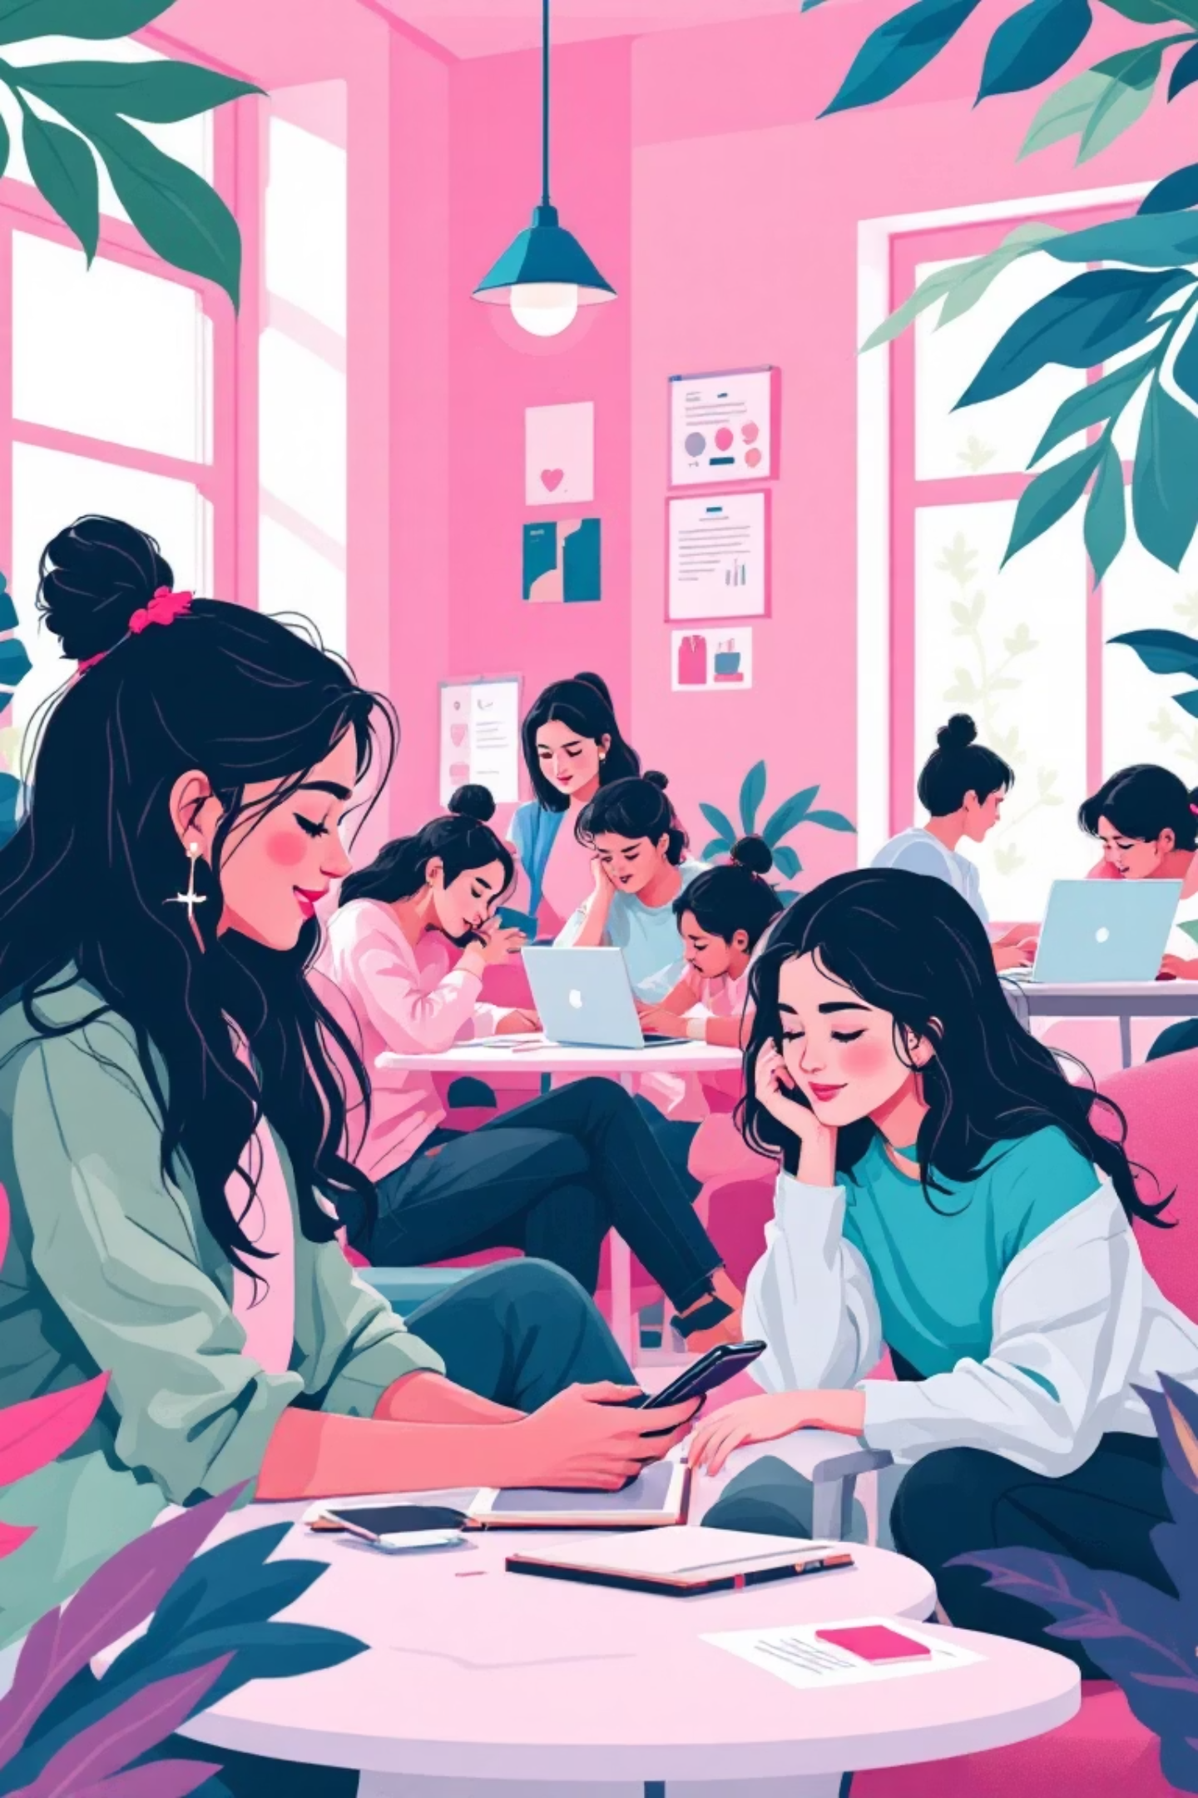
A Study of Social Media Usage among Junior College Students
A research project submitted under the M.Ed. programme of Savitribai Phule Pune University by Pandit Satish Devrao, guided by Prof. Dr. Prakash Jagtap at Tilak College of Education, Pune.

Slide 2

The Digital Transformation
In the 21st century, digital technology has significantly transformed student lifestyles. Junior college students actively engage with platforms like WhatsApp, Instagram, YouTube, Facebook, and Telegram during a crucial stage of academic and psychological development.
Social media provides instant access to information, peer interaction, and learning resources. However, excessive use may lead to distraction, reduced concentration, and poor study habits.

Slide 3
Research Landscape
Kaur & Singh (2019)
1
Descriptive survey revealed students used social media mainly for entertainment and social interaction rather than academics.
2
Patil (2020)
Study of 120 students showed moderate use supported learning, while excessive usage negatively affected concentration and academic performance.
Sharma & Verma (2021)
3
Quantitative study found increased social media time associated with reduced attention span and increased academic stress.
4
Joshi (2022)
Comparative study found urban students had higher social media usage than rural students due to better access to smartphones and internet.
Kamble (2023)
5
Highlighted that guided social media use can promote collaborative learning, peer discussion, and sharing of academic resources.

Slide 4





Why This Study Matters
For Students
For Teachers
Understand digital behaviour during a transitional stage of academic pressure and emotional development.
Integrate positive social media use into teaching-learning processes and understand student online behaviour.
For Parents
For Institutions
Guide children towards balanced and responsible social media use with awareness of online behaviour patterns.
Frame policies, awareness programmes, and digital literacy initiatives based on scientific findings.

Slide 5

Research Framework
Problem Statement
1
"A Study of Social Media Usage among Junior College Students" examining usage patterns and purposes systematically.
Key Definitions
2
Social Media Usage: Frequency, purpose, and duration measured through questionnaire. Junior College Students: Students in XI and XII standards, 2025-26.
Research Method
3
Survey method using self-constructed questionnaire for 300 students selected through convenient sampling.

Slide 6
Research Objectives
01
02
03
Study Usage Patterns
Identify Purposes
Assess Perceptions
Understand frequency, time spent, and common platforms preferred by junior college students.
Examine whether students use social media for academics, communication, entertainment, or social interaction.
Understand students' views about social media's role in learning, information sharing, and academic support.

Slide 7
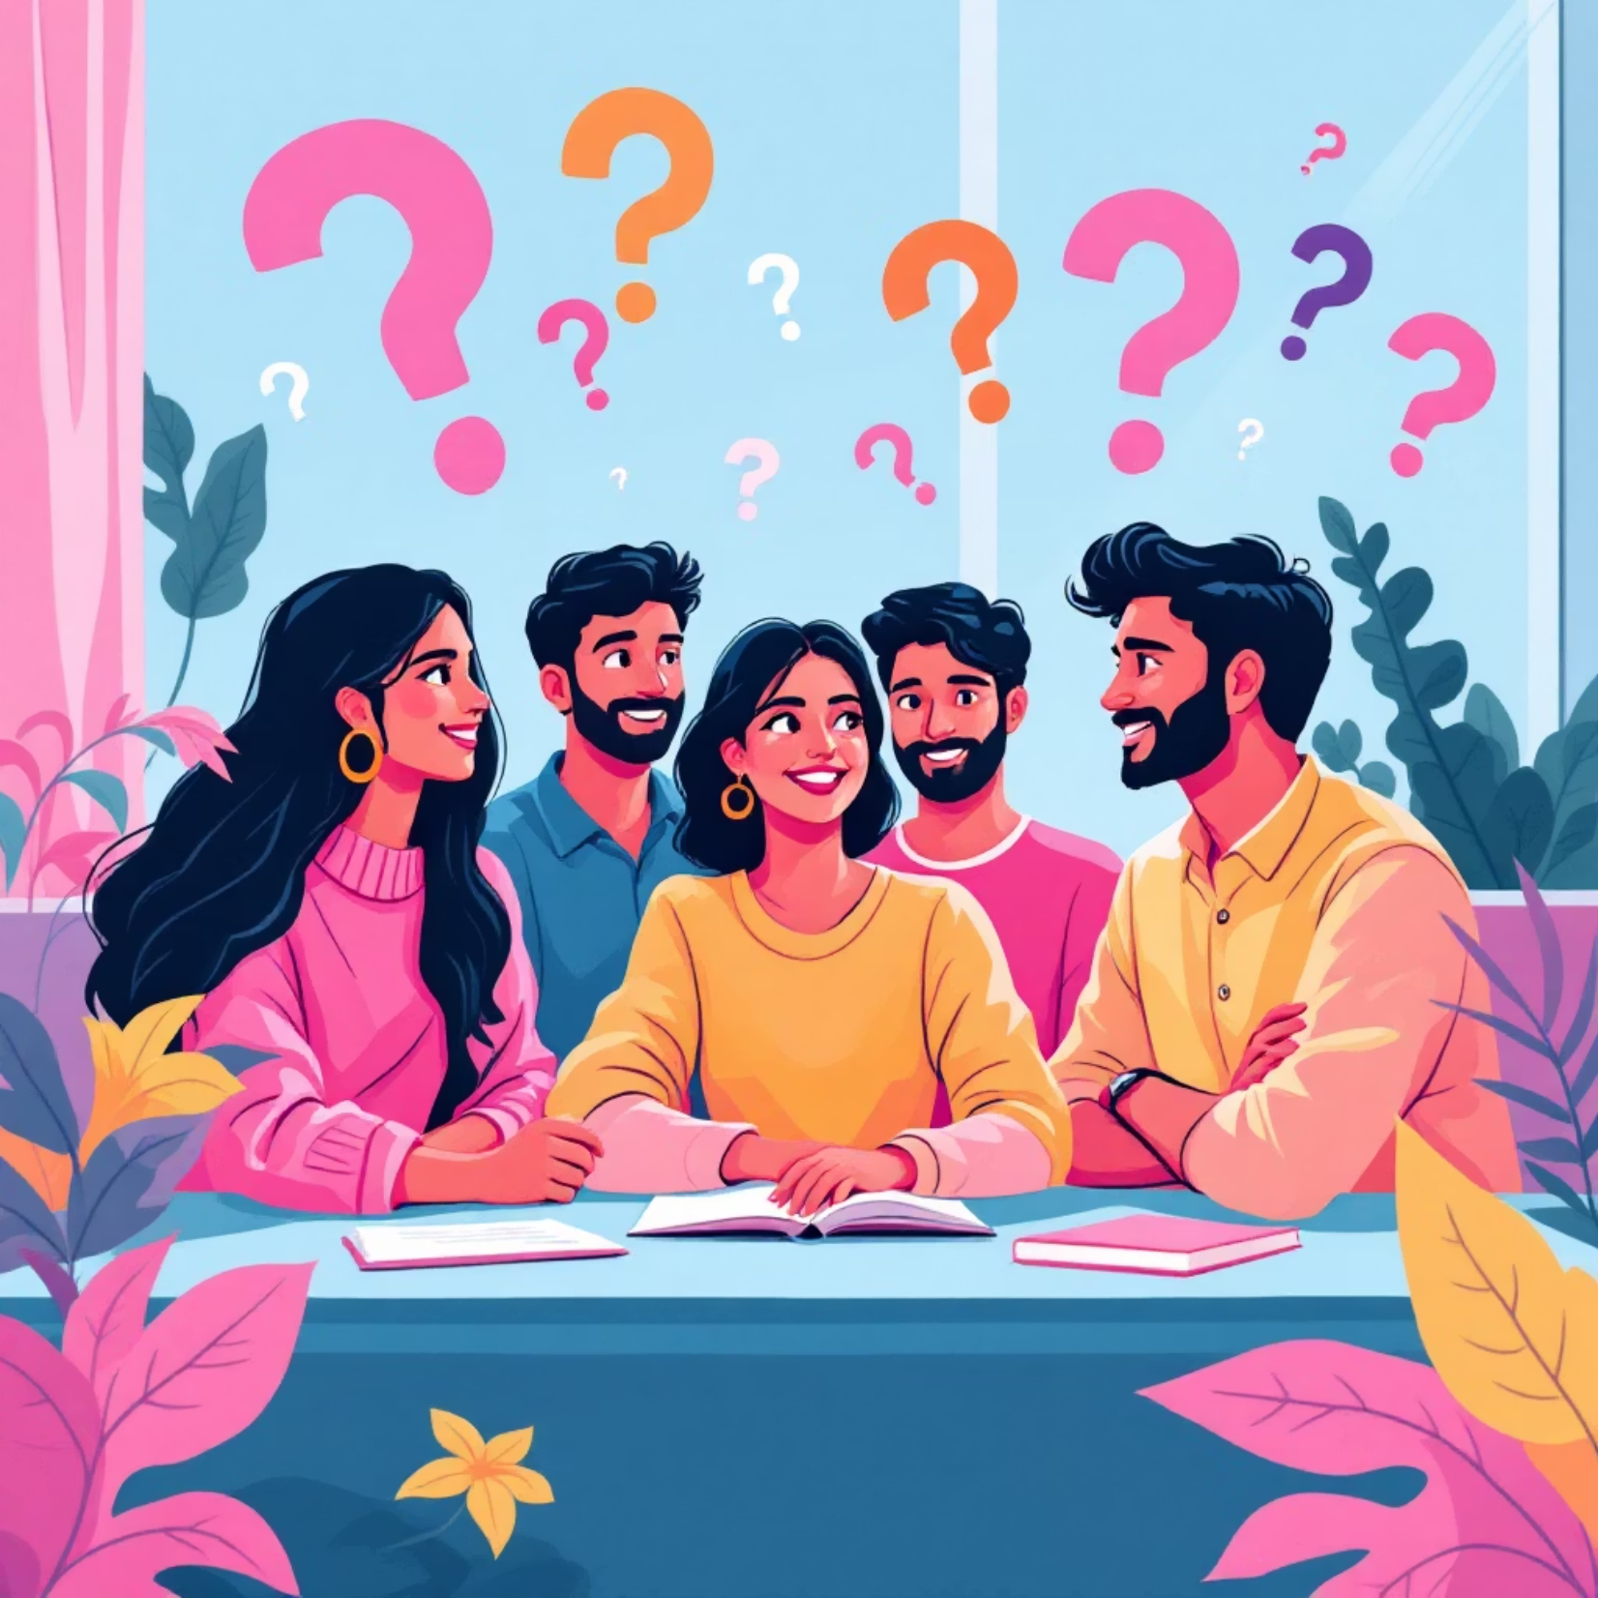
Research Questions
What is the frequency and duration of social media usage among junior college students?
For what academic and non-academic purposes do students use social media?
What are students' perceptions regarding educational usefulness of social media?
Is there a difference in usage patterns based on gender and academic stream?

Slide 8
Scope & Boundaries
Scope
Limitations
Delimitations
Focus on XI and XII standard students
Based on self-reported data through questionnaire
Limited to 300 junior college students
Examines frequency, purpose, duration, and educational use
May be affected by personal bias
Confined to selected colleges
Studies social media usage patterns comprehensively
Specific to academic year 2025-26
Depends on respondent honesty and awareness

Slide 9




Research Implementation
Data Collection
Self-constructed questionnaire with close-ended questions on usage frequency, duration, purposes, and perceptions.
Data Analysis
Percentage analysis with tables, bar graphs, and pie charts for clear visualization of findings.
Sample
300 students from XI and XII standards across different academic streams using convenient sampling.

Slide 10

Project Timeline & Budget
6-Month Schedule
Budget Breakdown
Proposal Preparation
₹1,500
₹1,000
1 Month
Tool Creation
Data Collection
Literature Review
1 Month
₹1,000
₹500
Tool Preparation
15 Days
Report Writing
Miscellaneous
Data Collection
Total Budget: ₹4,000 (approximately)
1.5 Months
Data Analysis
1 Month
Report Writing
1 Month

Slide 11
Thank you !

